Slide 1
Unit 5: For Live Session Assignment
Analysis of Variance!
(Comparing 3 or more means!)

Slide 2
Part 1

Slide 3
Quick Quiz Questions

Slide 4
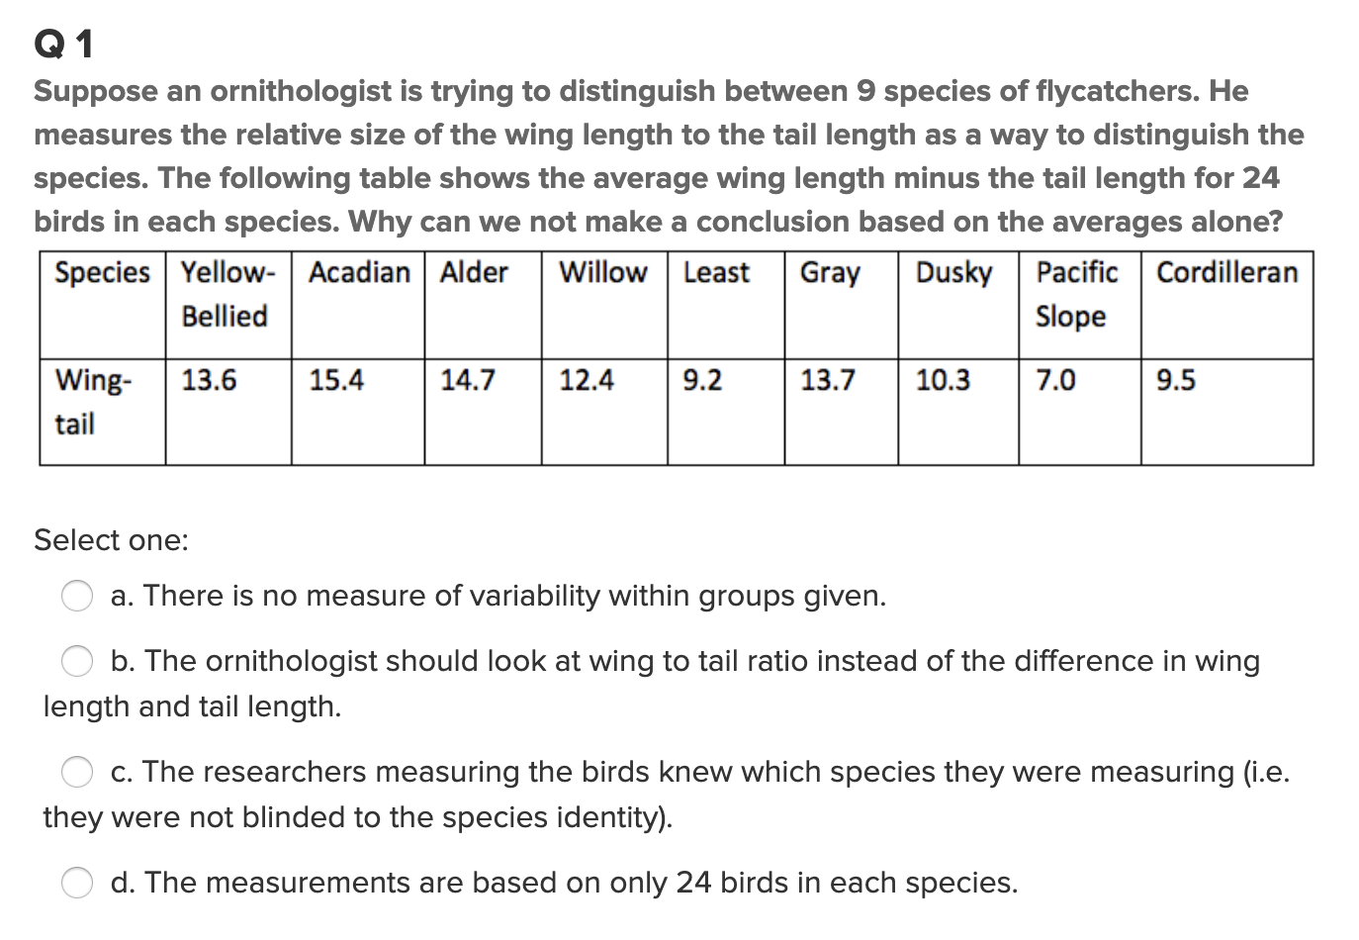
Question 1 (<15 min)

Slide 5
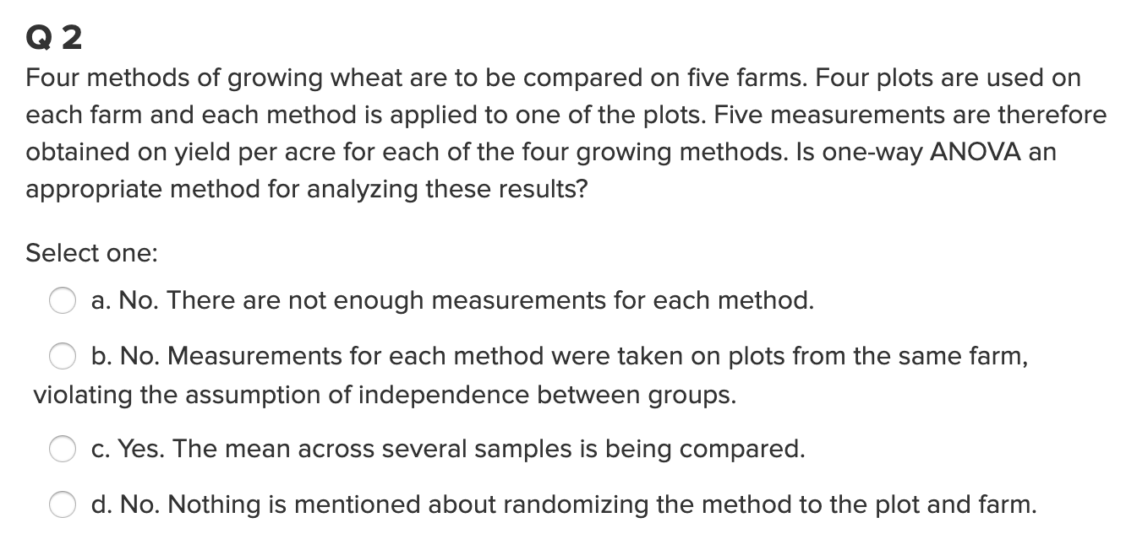
Question 2 (< 15 min)

Slide 6
End Part 1

Slide 7
Part 2

Slide 8
Check out the following example to help answer the problem that follows.

Slide 9
Archeology in New Mexico
An archeological dig in New Mexico yielded four sites with lots of artifacts. The depth (cm) that each artifact was found was recorded along with which site it was found in.
The researcher has reason to believe that sites 1 and 4 and sites 2 and 3 may be similar in age. In theory, the deeper the find, the older the village.
Is there any evidence that sites 1 and 4 have a mean depth that is different than the mean depth of artifacts from sites 2 and 3?

Slide 10
Archaeology Example
Depth | Site |  | Depth | Site |  | Depth | Site |  | Depth | Site
93 | 1 |  | 85 | 2 |  | 100 | 3 |  | 96 | 4
120 | 1 |  | 45 | 2 |  | 75 | 3 |  | 58 | 4
65 | 1 |  | 80 | 2 |  | 65 | 3 |  | 95 | 4
105 | 1 |  | 28 | 2 |  | 40 | 3 |  | 90 | 4
115 | 1 |  | 75 | 2 |  | 73 | 3 |  | 65 | 4
82 | 1 |  | 70 | 2 |  | 65 | 3 |  | 80 | 4
99 | 1 |  | 65 | 2 |  | 50 | 3 |  | 85 | 4
87 | 1 |  | 55 | 2 |  | 30 | 3 |  | 95 | 4
100 | 1 |  | 50 | 2 |  | 45 | 3 |  | 82 | 4
90 | 1 |  | 40 | 2 |  | 50 | 3
78 | 1 |  |  |  |  | 45 | 3
95 | 1 |  |  |  |  | 55 | 3
93 | 1
88 | 1
110 | 1

Slide 11
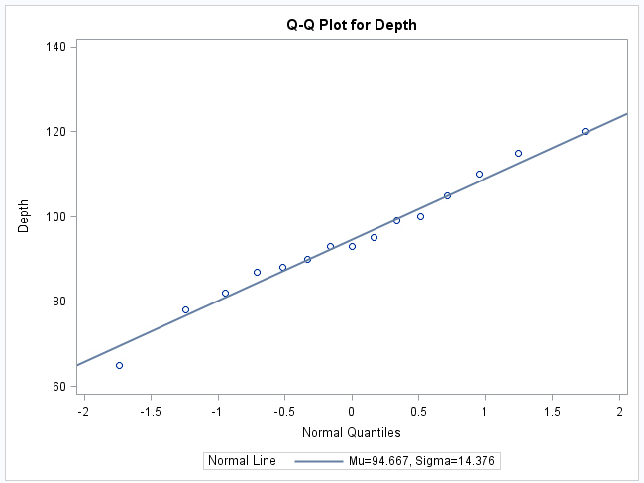
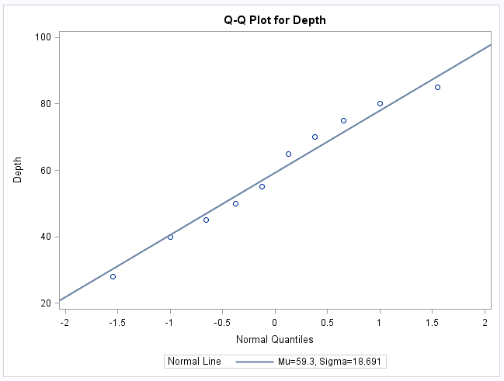
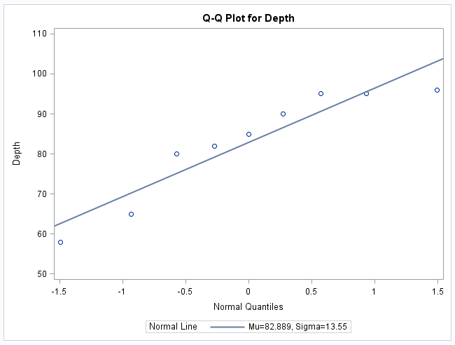
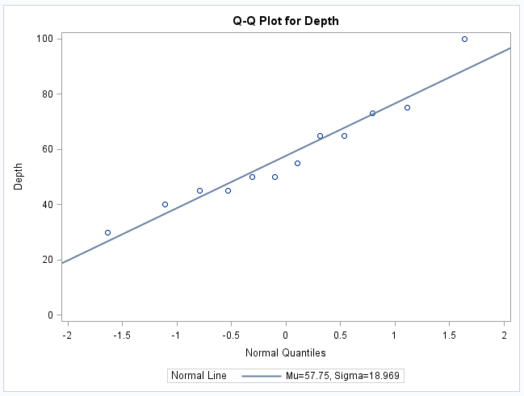
Archeology Example Assumptions: Normality
Histograms will be helpful as well!

Slide 12
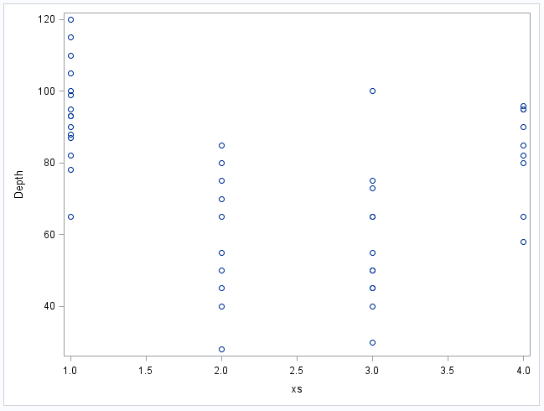
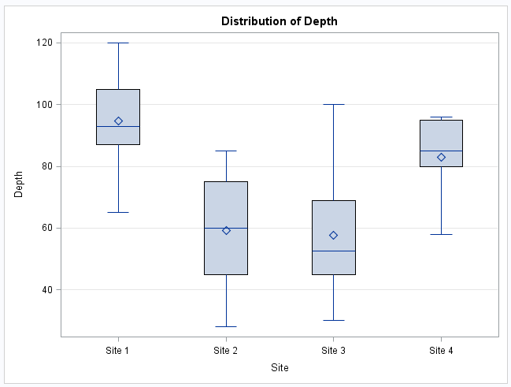
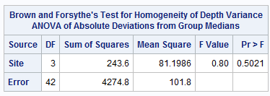
Archeology Example Assumptions: Homogeneity (Equal SD)

Slide 13
Archeology Example Assumption: Independence
The discovered artifacts associated with the depths were randomly selected from the log (book of recordings … not logarithms!) of discoveries.
Since the artifacts and, thus, the depths are associated with completely different sites, it is assumed that the data are independent between sites.

Slide 14
Question of Interest:
Is there statistically significant evidence any of the mean depths are different between different sites?

Slide 15
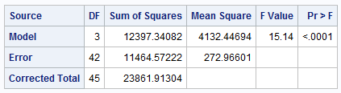
First Ask: Is there reason to believe any of them are different?
H₀: The mean depths of the artifacts are equal for each of the sites.
H_{A}: At least one pair of sites have different mean depths
There is strong evidence to suggest that at the alpha = .05 level of significance (p-value < .0001 from an ANOVA) that at least 2 of the sites have different mean depths.

Slide 16
End Archeology Example

Slide 17
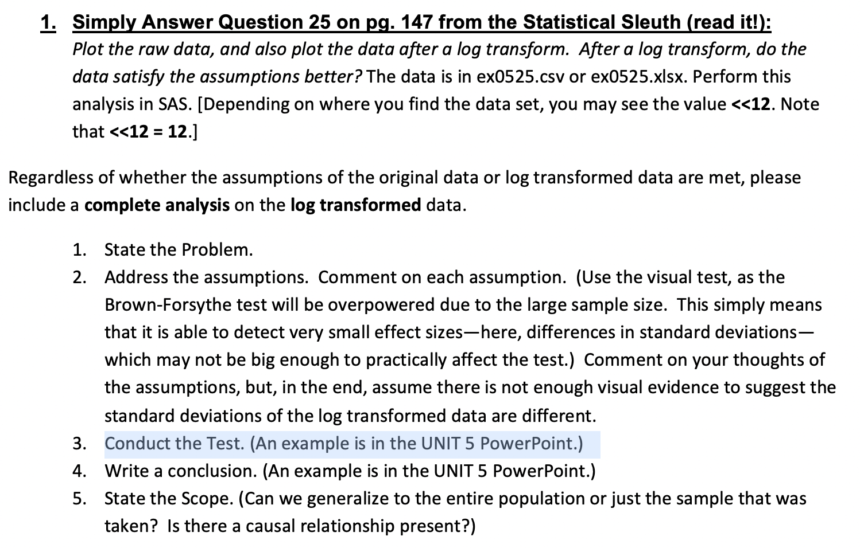
Question 1 ( < 2 hours ) just give it a shot and see how far you get.

Slide 18
End Part 2

Slide 19
Part 3

Slide 20
Takeaways and Questions (1 hour)
Please remember to record you takeways and any questions you may have!

Slide 21
End Part 3

Slide 22
End Unit 4 For Live Session Assignment

